Slide 1
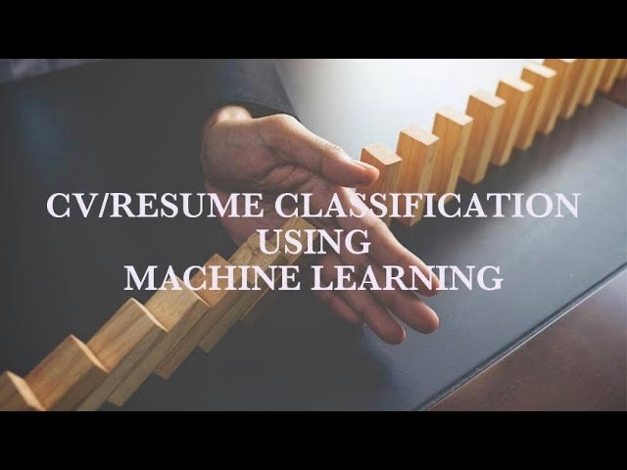
Project (P387)
Resume Classification
Mentor : Nilakshi Gogoi
Group - 2 Mahesh Pal
Vijay Kamble
Rama Govinda
Lionel Mendonsa
Indhu Cherukuri
Dhanashri Kanukale
Vijay Bhaskar Gunapalli

Slide 2
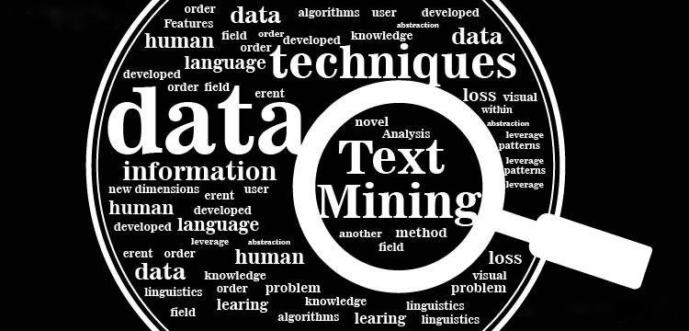
What is text mining?
Text mining, also known as text data mining, is the process of transforming unstructured text into a structured format to identify meaningful patterns and new insights. You can use text mining to analyze vast collections of textual materials to capture key concepts, trends and hidden relationships.

Slide 3
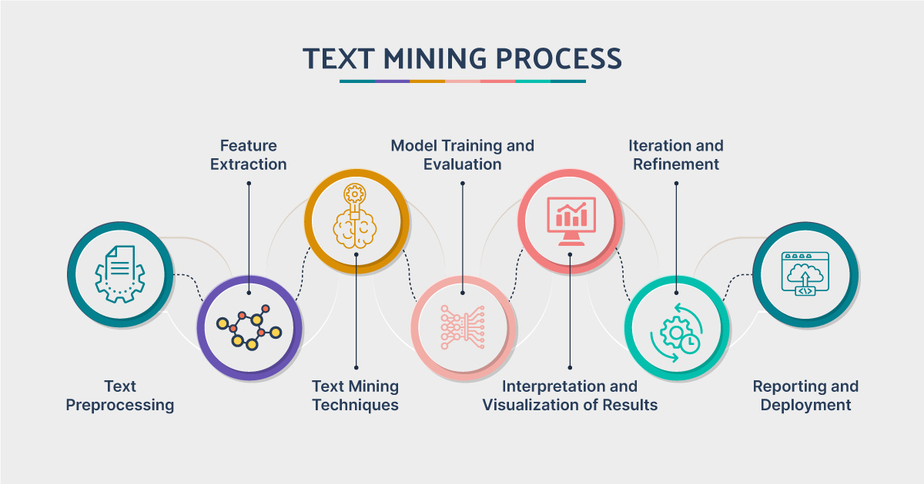

Slide 4
WHAT IS RESUME CLASSIFICATION?
Resume classification refers to the process of automatically categorizing or labeling resumes based on their content. This process is typically used in recruitment and HR to streamline the hiring process by organizing large volumes of resumes and identifying candidates who match specific job requirements or criteria.

Slide 5

OBJECTIVE
In resume classification, machine learning
techniques were employed to analyze the
textual content of resumes and assign them to predefined categories or classes.

Slide 6
OBJECTIVE
In this particular project we are given unstructured data i.e resumes of different people with different skill sets, through text mining techniques coverting them into structured format and using different classification and model building techniques, choosing the apt model, fitting it and evaluating the data, we will classify all the resumes and put each of them into there predefined categories here, such as
React JS Developer
Workday
SQL Developer
PeopleSoft

Slide 7
ABOUT DATASET
DATASET
The sample dataset contains 79 resumes of various applicants belonging
to 4 different predefined categories.
PREDEFINED CATEGORIES OF DATASET
React JS Developer
Workday
SQL Developer
People Soft

Slide 8
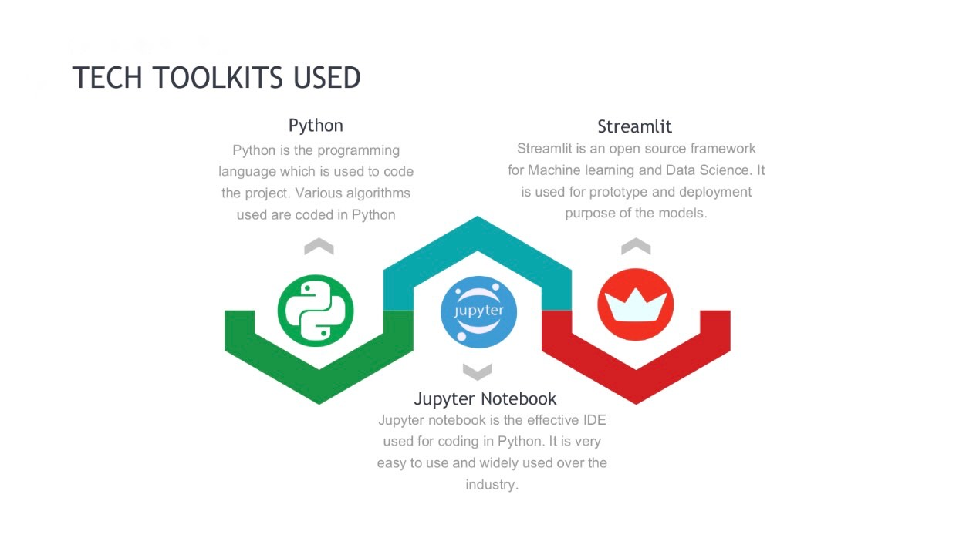

Slide 9
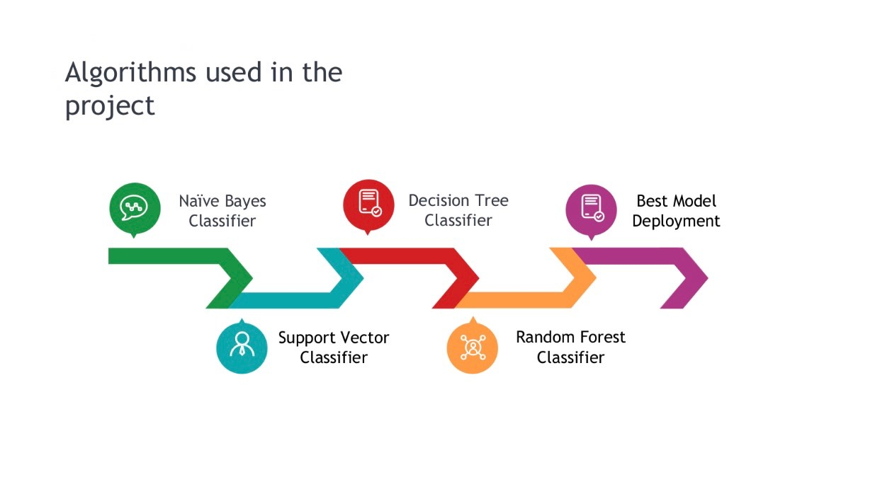

Slide 10
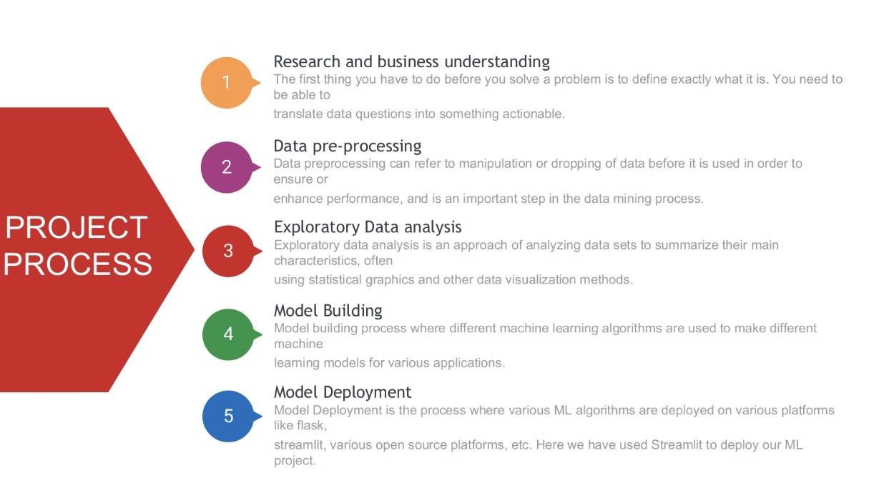

Slide 11
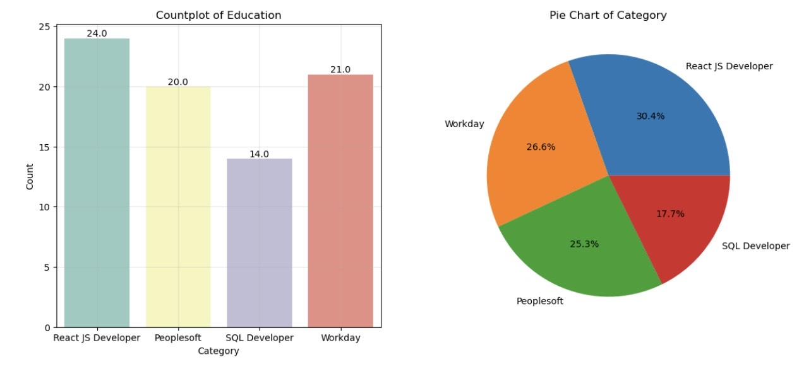
VISUALIZATION OF DATA

Slide 12
BEST MODEL
Once the data is cleaned and feature extraction is done.
The structured data is fitted into the best model evaluating the Train and Test accuracy.
The best model suitable for our data is:
RANDOM FOREST CLASSIFIER

Slide 13
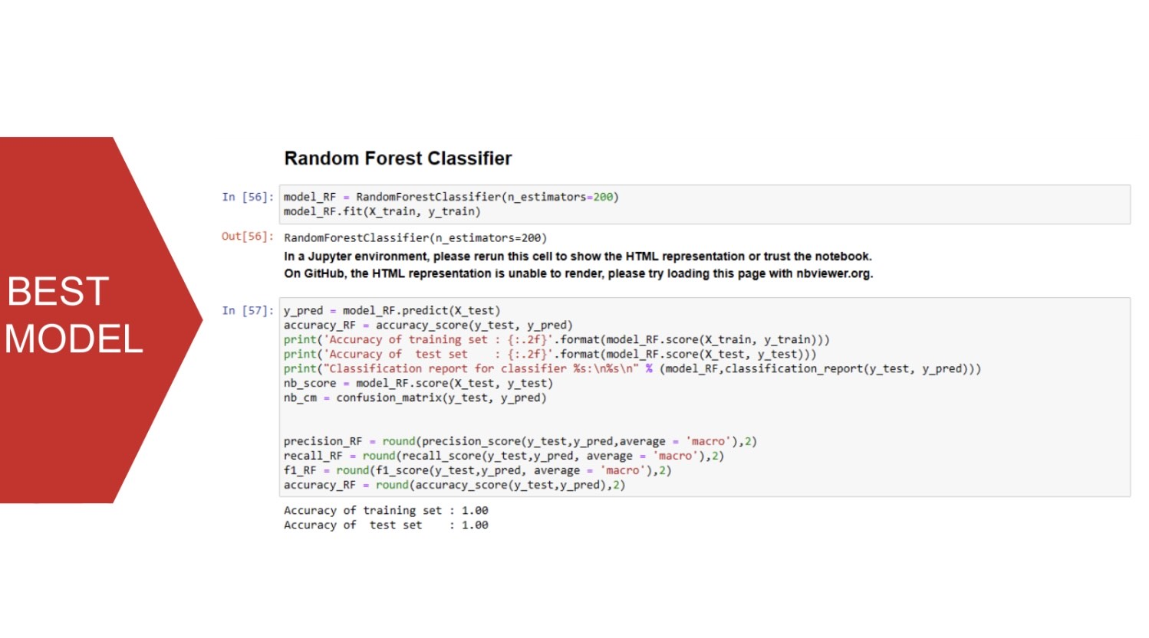

Slide 14
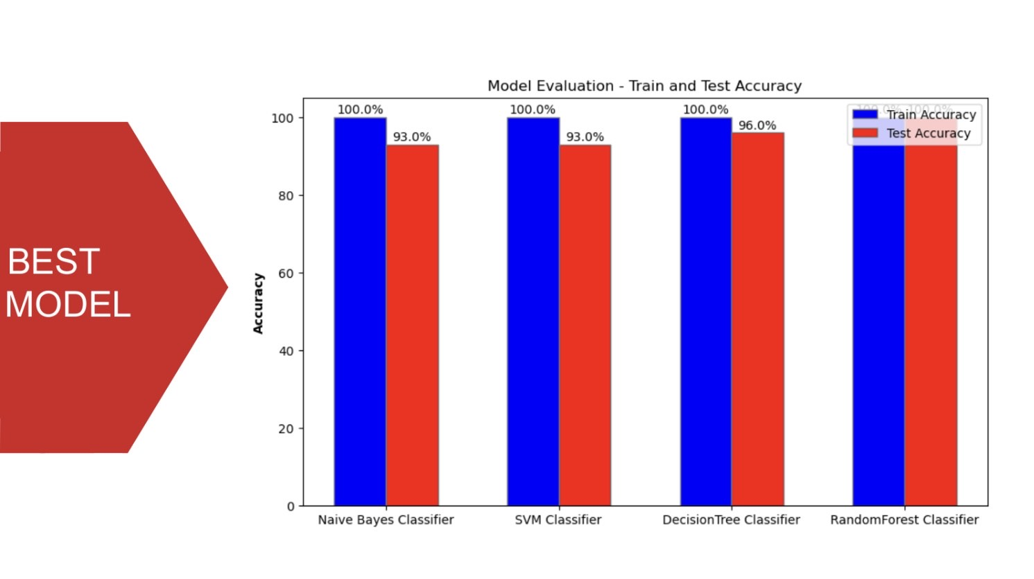

Slide 15
DEPLOYMENT
We have created a Streamlit Application based on this clustering technique, where we are taking applicants details i.e resume & identifying which cluster the applicant belongs to.

Slide 16
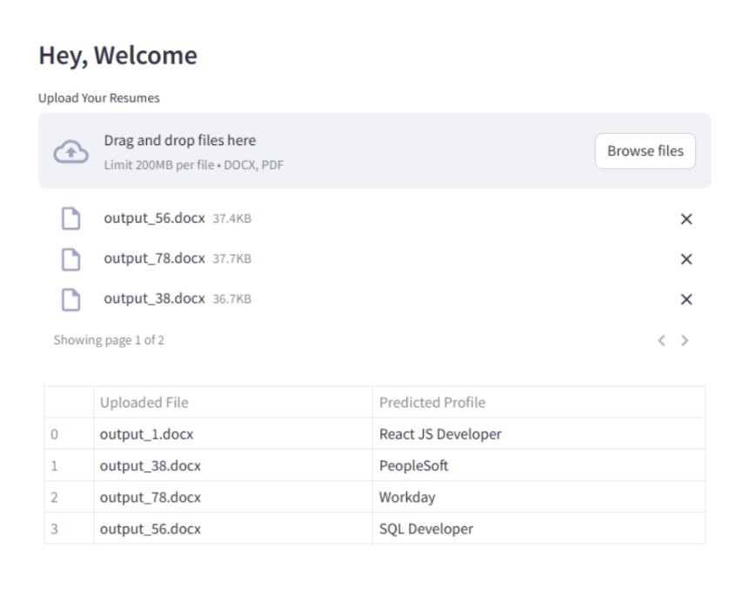
DEPLOYMENT PAGE

Slide 17
CHALLENGES FACED
Data Extraction Complexity:
Processing multiple file formats (docx, doc, pdf) requires handling different document structures and layouts for accurate data extraction.
Limited Data Availability
Achieving 100% accuracy with a small dataset might not be indicative of real-world performance.
A larger and more diverse dataset is needed for a more robust evaluation.

Slide 18


